Slide 1

TEAM CREW MATES (M.MAHATHI, V.SRIYA, N.GOWTHAMI)
PRESENTS
Mental Health Check-In
Chatbot
Mental health issues affect millions globally, but many people hesitate to seek help due to stigma, lack of access, or simply not knowing where to start.

Slide 2

The Problem
During times of stress or crisis, people need immediate support, but often professional help may not be instantly available. So, our Chatbot, WELL-BE will accompany you in the journey towards your best Mental Health.

Slide 3
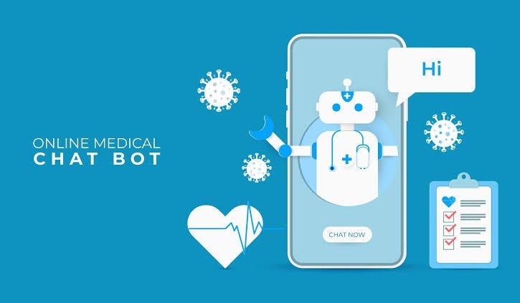
Our Solution
1
Empathetic Support
Our Mental Health Check-In Chatbot offers an empathetic and supportive space for users to track their emotions, receive personalized feedback, and access helpful resources in real-time.
2
Natural Language Processing
The bot uses Dialogflow’s natural language processing (NLP) engine to understand user emotions and provide responses that validate their feelings.
3
Real-Time Support
Users engage with the chatbot by sharing how they feel through text, and the bot provides tailored responses based on the user's emotional state.
4
Crisis Management
In urgent situations, the bot can seamlessly direct users to professional helplines or emergency support.

Slide 4
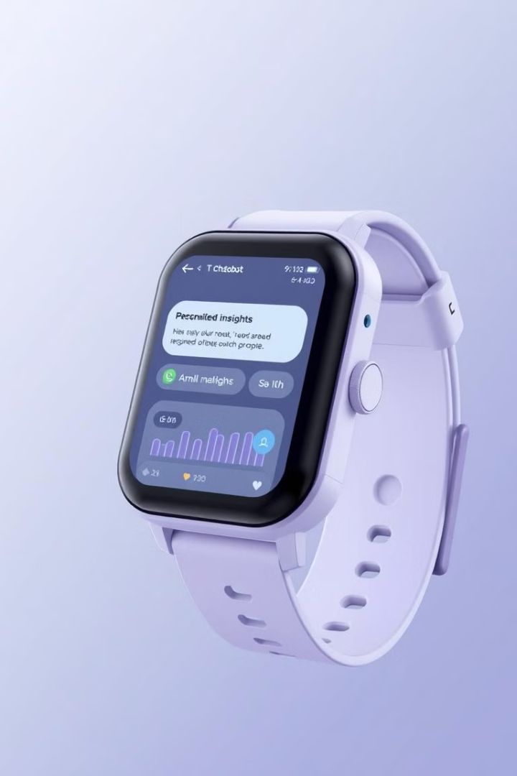




Future Potential & Scalability
AI-Driven Sentiment Analysis
We plan to incorporate AI-driven sentiment analysis to provide more nuanced emotional feedback.
Deeper Integration with Therapy Resources
We plan to incorporate deeper integration with therapy resources or mindfulness exercises.
Expansion
In the future, this chatbot can be integrated with wearable devices to track physiological indicators of stress.
Customization
We could also tailor this solution for different demographics, like teenagers, employees in high-stress jobs, or even senior citizens.

Slide 5
Key Features
Emotion Detection
Mood Tracking
Crisis Support
Our bot uses NLP to detect user emotions based on input, whether they express sadness, anxiety, or happiness.
It helps users track their mood trends over time, promoting self-awareness and encouraging mental wellness check-ins.
In urgent situations, the bot can seamlessly direct users to professional helplines or emergency support.

Slide 6
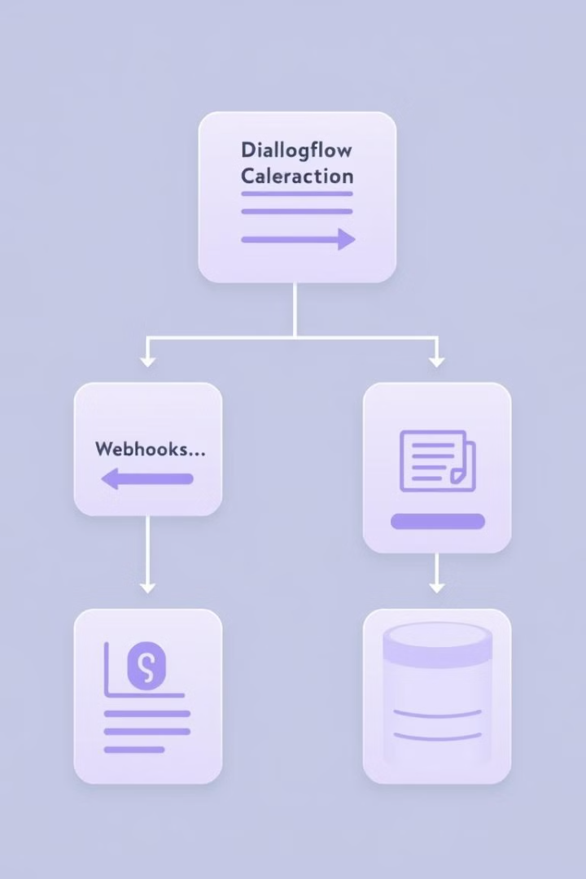
Technical Implementation
1
Dialogflow for NLP
We leveraged Dialogflow's natural language processing to handle various user inputs, identify emotions, and trigger appropriate intents.
2
Custom Intents & Entities
We created specific intents for different emotional states like sadness, anxiety, and joy, and added custom entities to better understand variations in user input.
3
Webhook for Advanced Processing
4
User Interface
The chatbot is embedded into a user-friendly web interface that is mobile-responsive and accessible.

Slide 7

Impact & Value Proposition
Accessibility
By providing an anonymous, easy-to-access tool, we're lowering the barrier for mental health check-ins, particularly for those who may not feel comfortable seeking traditional support.
Proactive Mental Health Care
Our bot encourages daily or weekly emotional self-check-ins, promoting early detection of mental health issues before they become critical
Scalability
This chatbot can be deployed in a variety of contexts – from personal use to corporate wellness programs, schools, and mental health organizations.

Slide 8
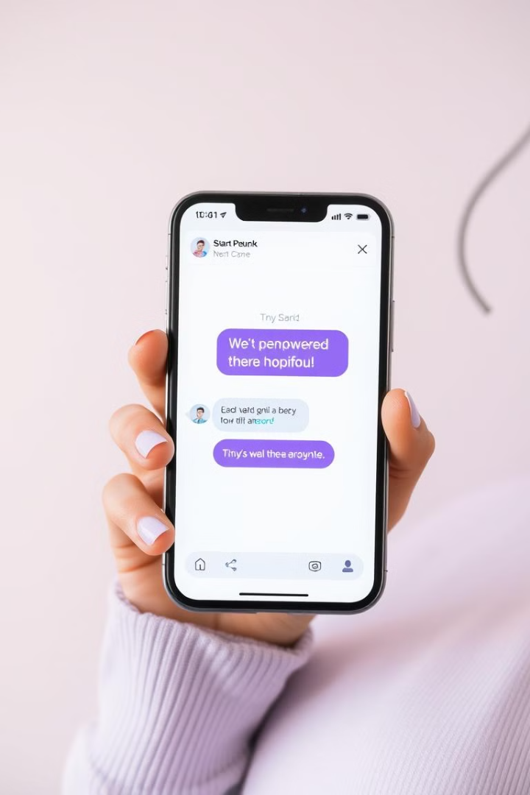



The Hack & Innovation
Empathy-Driven NLP
What sets our chatbot apart is its combination of empathy-driven NLP with real-time crisis support.
Real-Time Crisis Support
It's not just a conversation tool, but a mental health companion that evolves with the user's emotional journey.
Hack Details
In this hackathon, we focused on fine-tuning Dialogflow's NLP engine to ensure high accuracy in detecting emotions, created and integrated a scalable crisis management system.

